Slide 1
County Currency
Revitalizing Rural Culture

Slide 2
The First Computer
Which Ivy League University?

Slide 3
Iowa State University
Then known as:
Iowa State College of Agricultural and Mechanic Arts

Slide 4
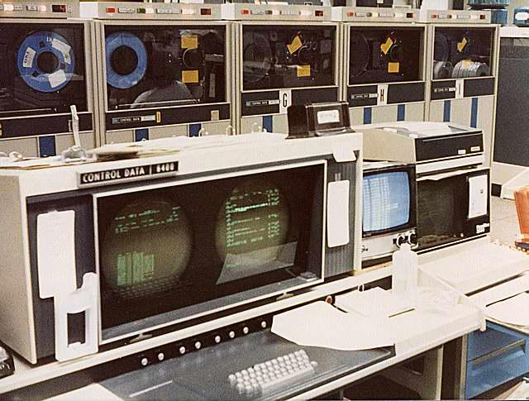
The First Supercomputer
Which National Laboratory Invented It?

Slide 5
Out Back of Seymour’s
Rural Chippewa Falls

Slide 6
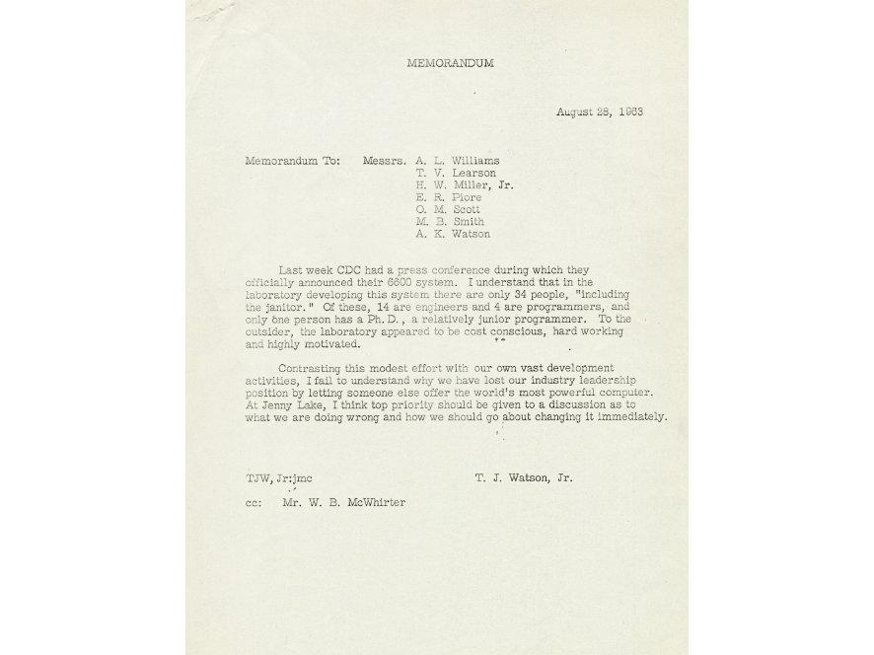

Slide 7
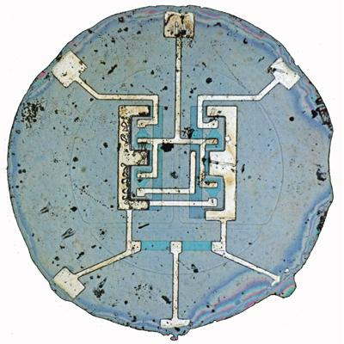
Inventor Of Microchip
Came From Which Major City In India?

Slide 8
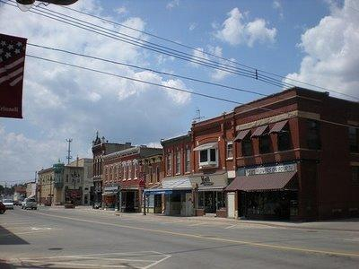
Grinnell
A megalopolis of that legendary province of India known as “Iowa”.

Slide 9
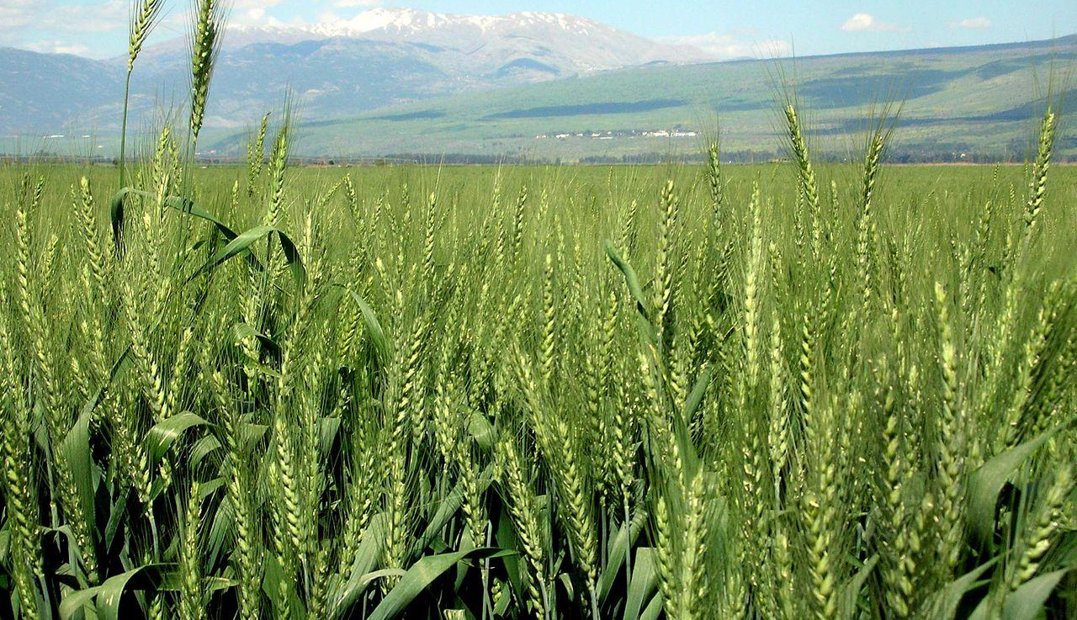
The Green Revolution
Came From Which Major City In India?

Slide 10
Cresco
Another megalopolis of that legendary province of India known as “Iowa”.

Slide 11
The Green Revolution Fed Billions of People and That’s Why, Today, Places Like Cresco, Iowa Are Multiplying Like Rabbits!

Slide 12
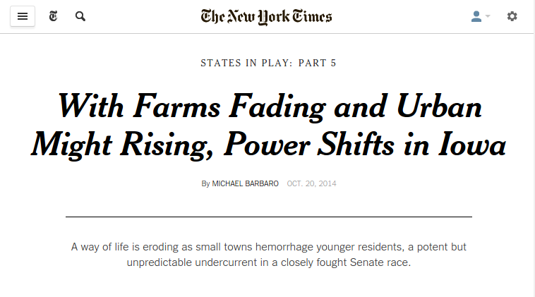
New York Times Triumphalism

Slide 13
OOPS

Slide 14
Global Economy vs Rural Culture
10,000 years ago agriculture arose but now its small-community heritage is discarded
National security eroding
Where there is no vision, the people perish

Slide 15
The higher education nightmare
Three mortgage-sized debts per family
Student loan debt not dischargable in bankruptcy
Graduates have decreasing job prospects due to globalization
The two income trap of young family formation dangerously delays childbearing

Slide 16
National Security Eroding
Centralization is more efficient but less resilient to attack and corruption
Global “financial meltdowns” more of a danger than ever
Greater openness to pandemics whether biological (ebola) or cultural (ISIS)

Slide 17
The Illusion of the Gold City
Even with high incomes, responsible family formation not affordable by most in cities
Casino-like career gambles to afford families
Addictions as substitute for stable families
Eat, Drink and Be Merry For We Have No Children!

Slide 18
Localization Is the Answer
Every home a land grant college
Local self-sufficiency for national security
Best of both worlds for young rural families with children

Slide 19
Revitalization of Higher Education
Even Ivy League graduate courses are now available to rural areas online at low cost
Hands-on apprenticeships for advanced technical skills from the likes of the inventors of the computer, supercomputer, microchip and green revolution
Married student childcare from long-time local acquaintances

Slide 20
Pioneering National Security
Local provision of essentials
Reserve deputies as foundation of defense
Ability to isolate and quarantine if necessary

Slide 21
The Best Of Both Worlds
Artisanal culture including local
Foods
Arts
Architecture
Affordable family formation

Slide 22
HOW?

Slide 23
County Currency
To grow “big enough” local economies, county governments gradually issue their own currencies in the form of transferable tax credits good for county tax liabilities.
That’s it!

Slide 24
Why Is Now the Time?
The Internet Is Mature Infrastructure
A Revolution in Flexible Manufacturing
People Are Wising Up To
The Casino of the Global Economy
The Value of Family and Friends

Slide 25
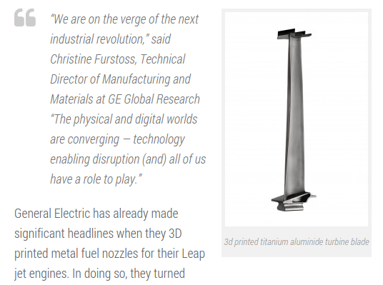

Slide 26
Local Motors Microfactory
Manufacturing 250 Custom Cars Per Year

Slide 27
Custom Vehicles
Even Military Grade All Terrain Vehicles

Slide 28
Flexible Manufacturing
Open source designs freely available
The New Machine Shop Cost Declines
3D printers in a wide range of sizes, precisions and material properties
Traditional CNC mills and lathes
RepRap culture aiming at partially-replicating machine shops

Slide 29
Localize Human Services
Time exchanges for caregivers
Israeli “MamaZone” daycare exchange
Japanese “Fureai kippu” eldercare
Professionals will accept tax credits
Incentives for volunteers
Material support for human services

Slide 30
The Currency Machinery

Slide 31
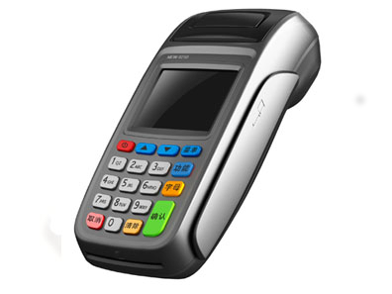
The Currency Machinery
Hand Held Point of Sale

Slide 32
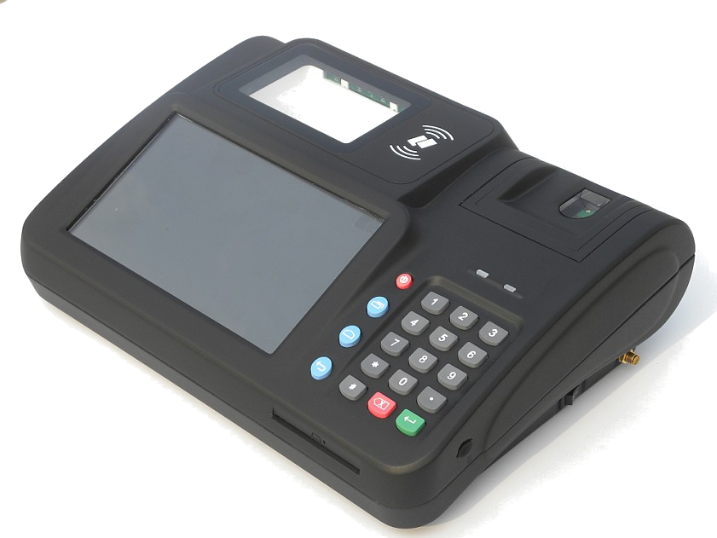
The Currency Machinery

Slide 33
The Currency Machinery
Recommended by Bernard Lietaer
Payservices.com
Turn-key services for local currencies
Smart County Citizen Id Cards ($1 each)
Point of Sale Stations ($500 each)
Full Credit/Debit Card Interface
Terms Negotiable

Slide 34
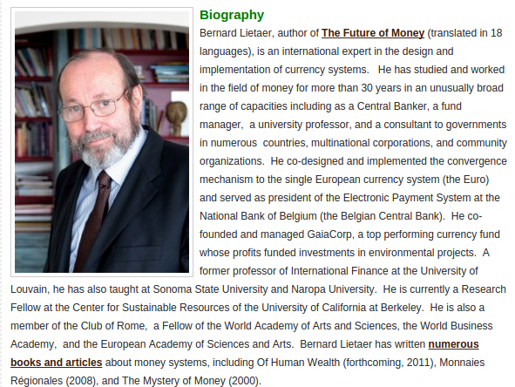

Slide 35
Call to Action
Study the potential impact of county currency in Fremont County, IA, drawing on experts in the emerging field of crypto-currency as well as traditional monetary systems and their associated infrastructure such as PaySystems.com.

Slide 36
Questions?
Thank you for your time.

